Slide 1



ENTERPRISE IT SOLUTIONS PROVIDER
RAPTOR EYE SIEM PROFILE

Slide 2

INTRODUCTION
Absolute Solutions is a global market player with 2 decades of excellence in delivering IT services to international market. Our software development infrastructure is based on continuously integrated open source technology platforms. Our development standards are inherited from CMMI and IEEE and we are the authorized reseller and distributor for multiple products.
We have a rapidly growing channel partners network in 14 countries. The company has evolved from a software development house to a multi-channel business platform that combines the expertise of many renowned business icons and has blended their products with its own unique services to yield a synergy that can offer end-to- end solutions to its customers.
The company started its operation in January 2002 from Middle East and is being run and supervised by an educated, young and visionary Pakistani management.

Slide 3

VISION
INTEGRATING IT AND MINDS TOGETHER
Our vision is to create adaptable, innovative, and perspective solutions that enhance effectiveness and results. We are the market specialized in providing technology solutions to a broad range of businesses and we aim to become the go-to transformation partner for clients who are driven to thrive in a world that is changing quickly so that we can all work together to determine the future of business.

Slide 4
OUR CLIENTS
Our clients are not only businesses for us. They are our partners, in which we invest all our resources to make sure each venture is a success.
With the vision of Absolute Solutions, we are proud to have provided solutions and systems for some big names to efficiate their business goals.

Slide 5









Slide 6













Slide 7
PURPOSE OF DOCUMENT
This document entails the complete working, structure and architecture of Raptor Eye SIEM Solution.

Slide 8
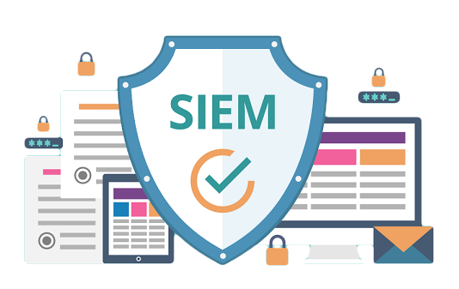
RAPTOR EYE
SIEM SOLUTION

Slide 9
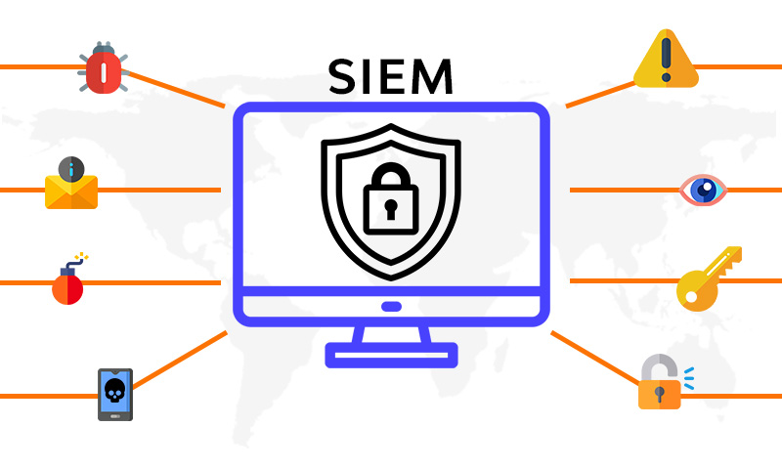
Introduction to SIEM Solution
Raptor Eye is a comprehensive SIEM solution for threat intelligence, intrusion and vulnerability detection, security monitoring of assets, incident response, file integrity monitoring and regulatory compliance across the network.
It can efficiently guard the assets and network from various high risk attack vectors.

Slide 10
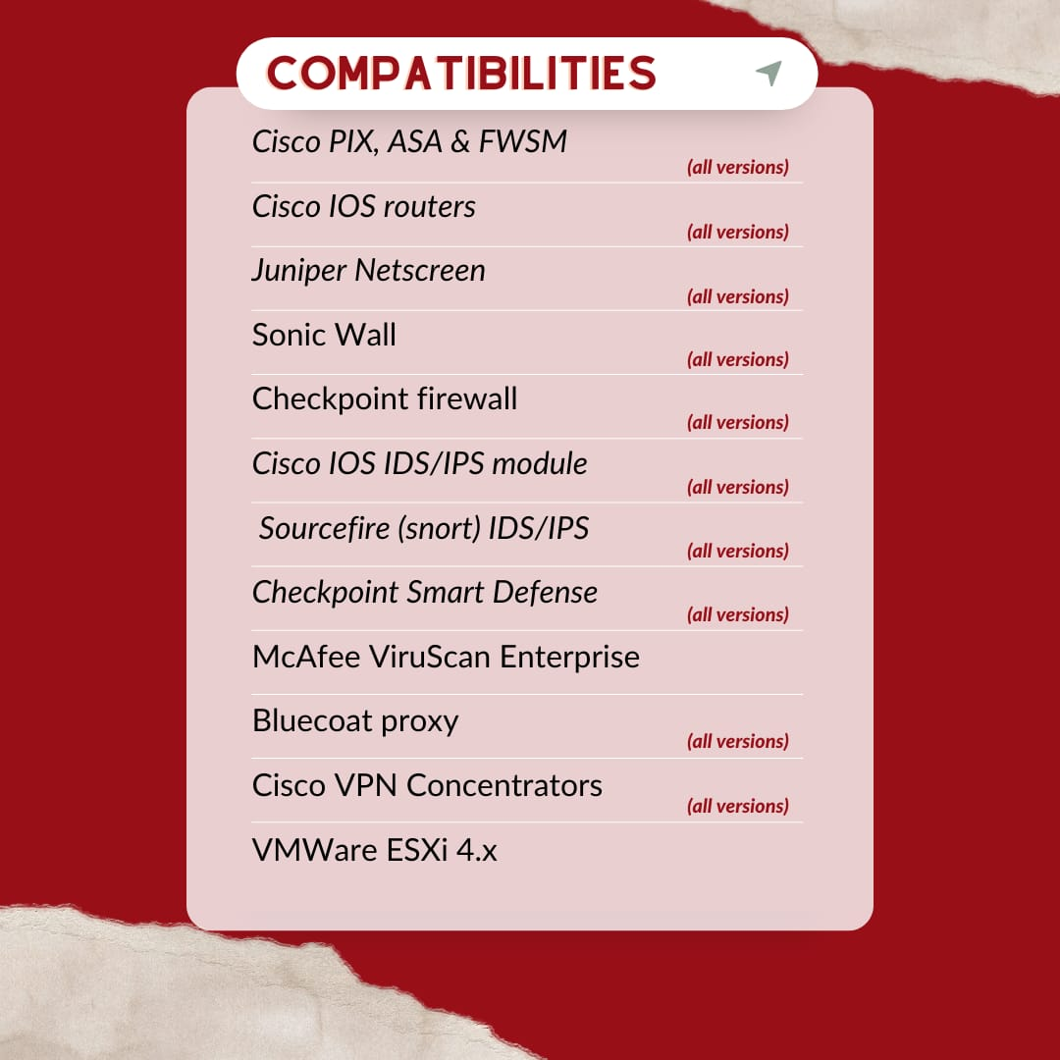

Slide 11
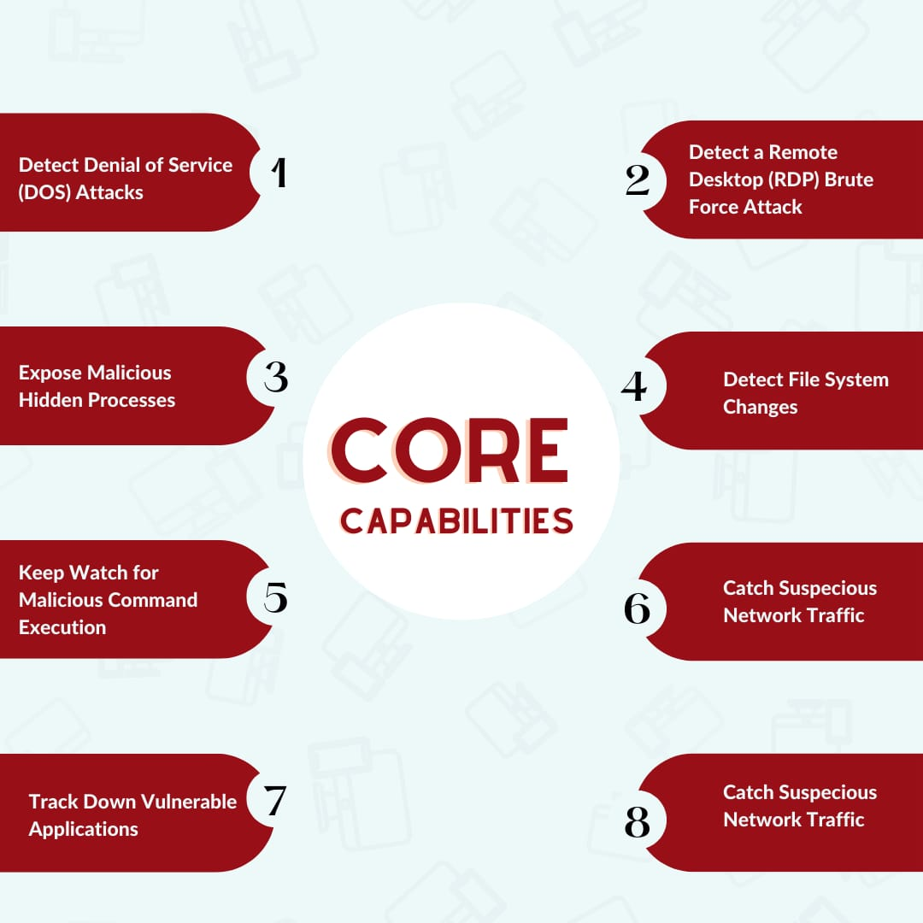

Slide 12
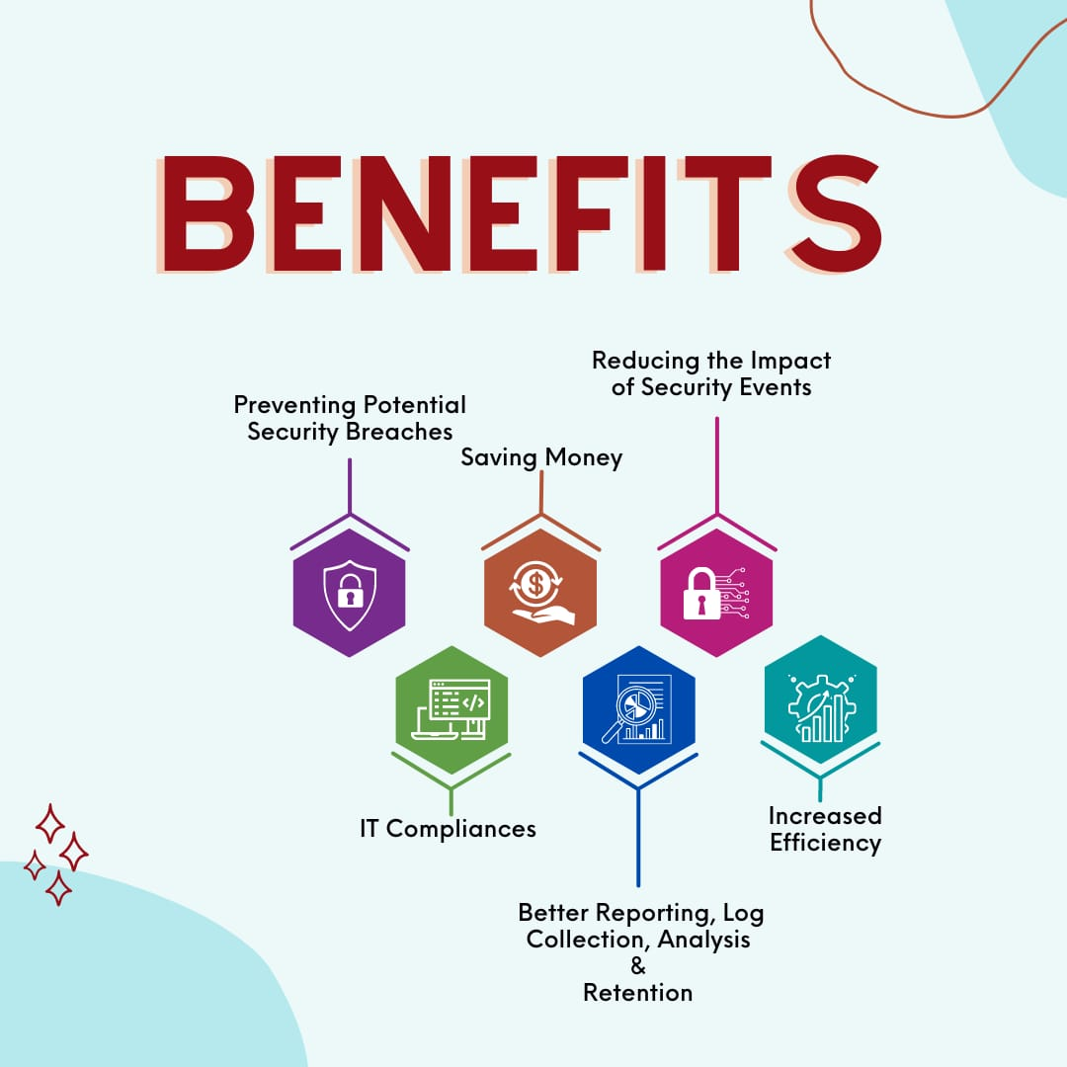

Slide 13
RAPTOR EYE AGENT AND MANAGER
Agent
provides threat
prevention, detection, and response capabilities
collect different
types of system and application data for Eagle Eye Manager
Manager
manage assets across the network
analyzing the pertinent data received from the agents

Slide 14
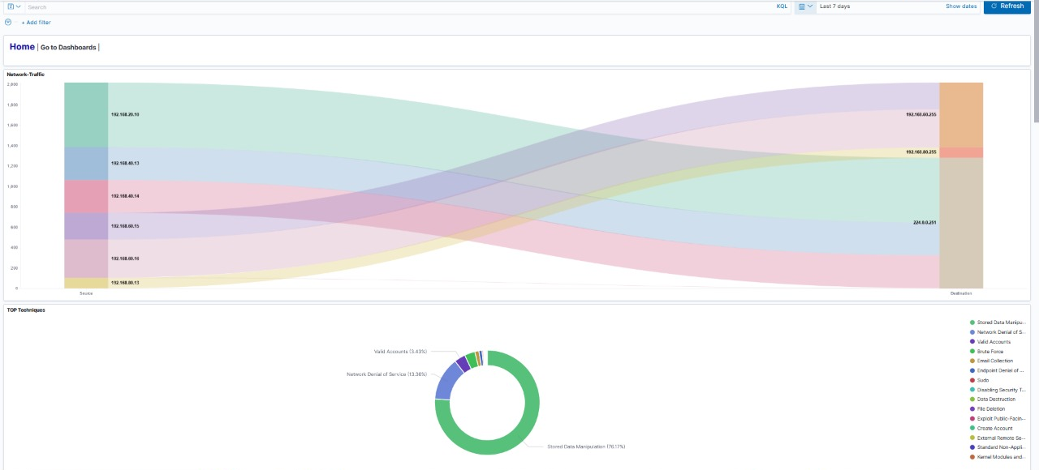
Homepage of Raptor Eye SIEM. It depicts information about flow of traffic from source to destination nodes through the firewalls that our SIEM monitored.

Slide 15
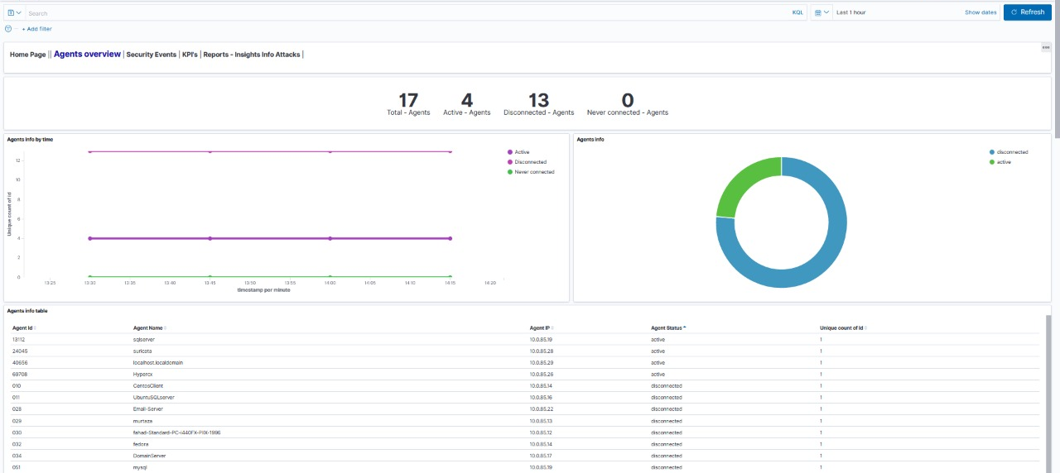
This graph depicts information about total agents, active and disconnected agents. Agents are the part of our SIEM, that we have installed on the devices which we want to monitor. These agents send logs to our SIEM manager.

Slide 16
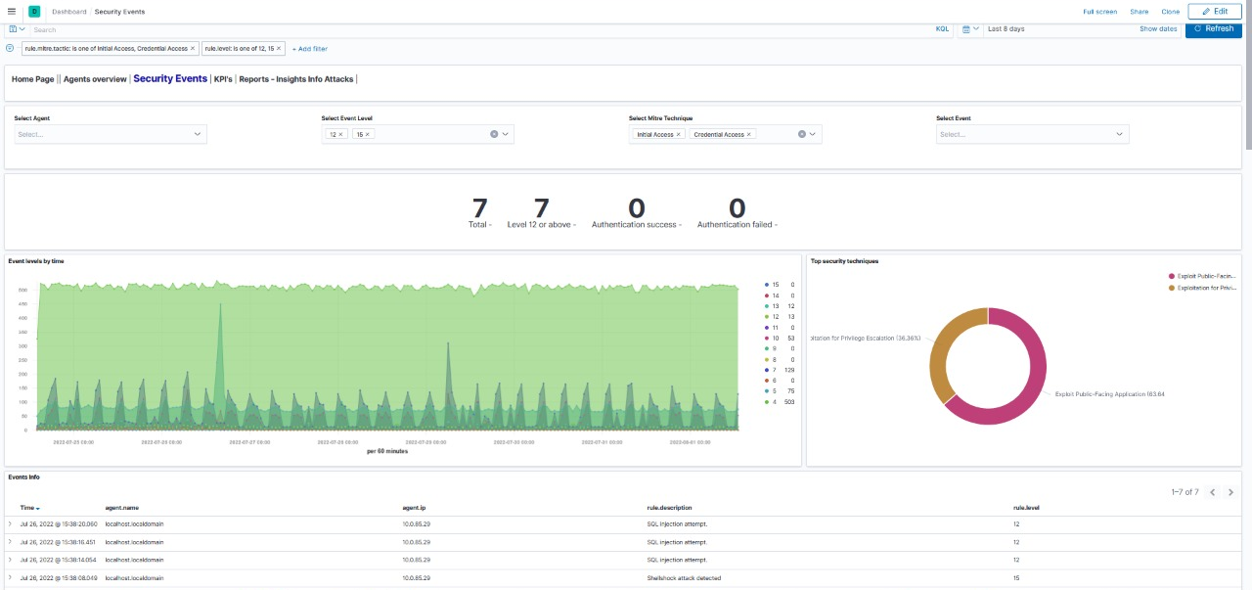
This graph depicts live information of all the agents(devices) events. Events that are 12 or higher are considered critical. (e.g. an SQL injection attack and shellshock attack is displayed above)

Slide 17
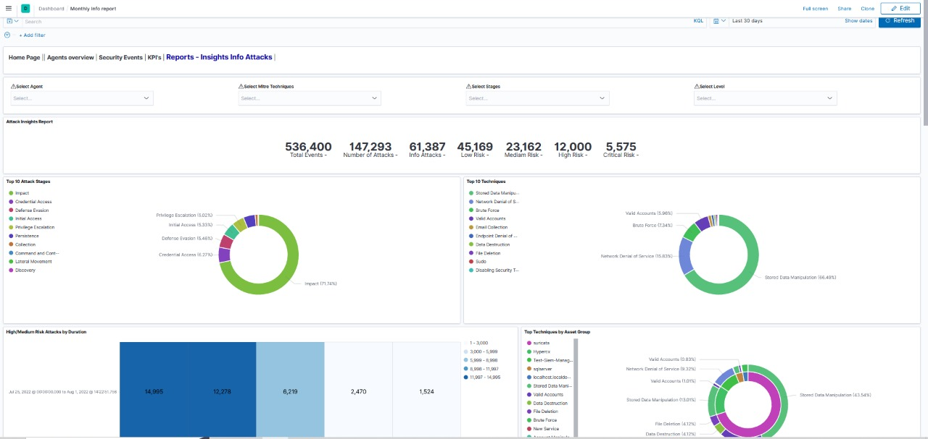
This graph is the monthly report of all the agent events that our SIEM monitored. These reports can be customized for a particular agent as well.

Slide 18
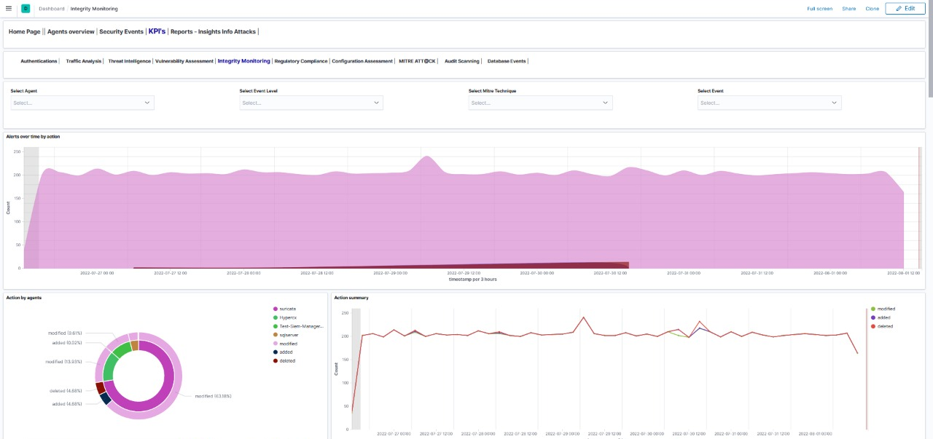
This graph depicts information about integrity related events when detected. Whenever any file is created, deleted, or modified it will display an alert and give all the information about that event.

Slide 19
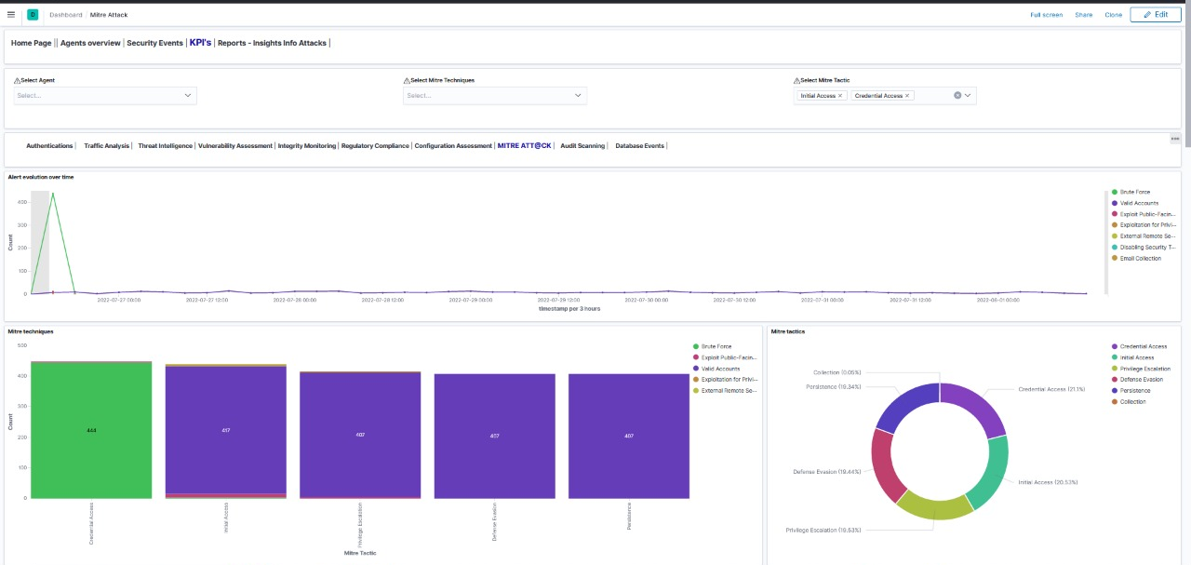
This graph depicts information about Adversarial Tactics (Credential access), Techniques (Brute force), and Common Knowledge. MITRE ATT&CK is a guideline for classifying and describing cyber attacks and intrusions

Slide 20
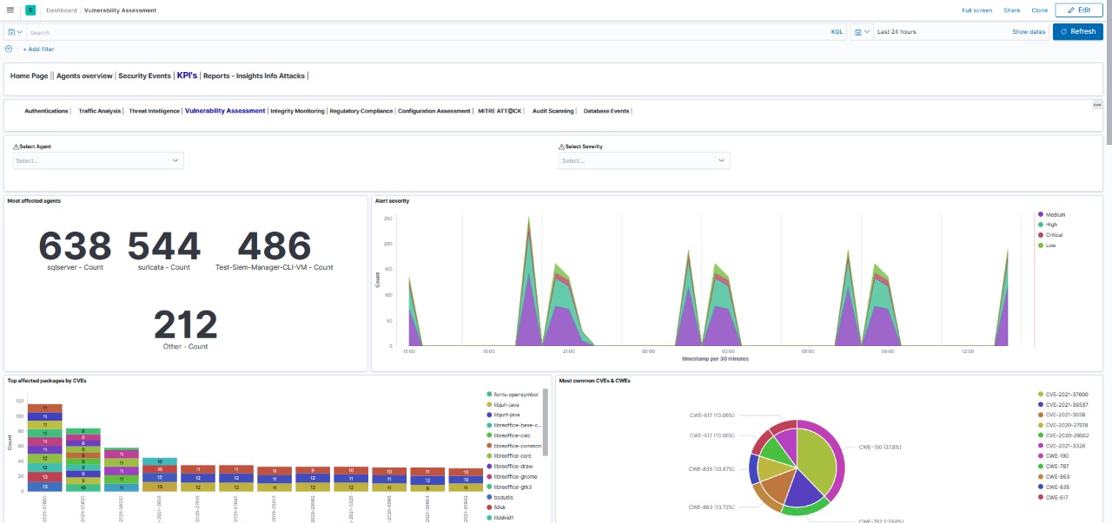
The vulnerability assessment is a systematic review of any security weaknesses in an information system. It evaluates all the software that are installed in the system to check if the system is susceptible to any known vulnerabilities, assigns severity levels to those vulnerabilities from low, medium, high to critical, and recommends remediation or mitigation, if and whenever needed.
This graph depicts information about vulnerabilities, our SIEM checks all the software versions that are installed in the system and check if they are vulnerable or not.

Slide 21
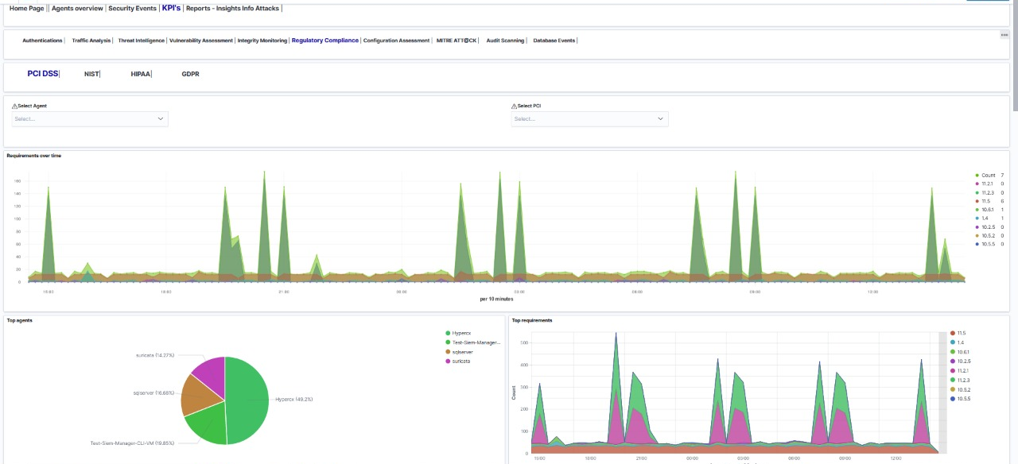
Regulatory compliance is the act of ensuring that an organization adherence to laws, regulations, guidelines and specifications to conduct business. Our SIEM check compliance with PCI DSS (Payment Card Industry Data Security Standard), NIST (National Institute of Standards and Technology), HIPAA (Health Insurance Portability and Accountability Act) and GDPR (General Data Protection Regulation).

Slide 22
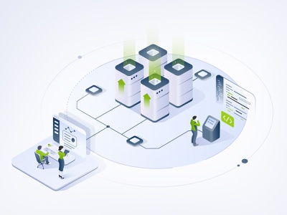
ON-PREMISE INSTALLATION OF RAPTOR EYE
In an on-premises environment, resources that are required for the SIEM are deployed in-house and within an enterprise’s IT infrastructure. On-premises SIEM solutions offer organizations complete control over data, since the data is stored on their own premises. It is more secure method as SIEM is deployed in house.

Slide 23

ON-CLOUD INSTALLATION OF RAPTOR EYE
Cloud-based SIEM (also referred to as SIEM-as-a-Service), takes SIEM to the next level, providing IT teams with greater convenience, flexibility, and power when managing threats across multiple environments – both on-premises and in the cloud. Cloud-based SIEM provides an effective and efficient way to constantly monitor all devices, servers, applications, users, and infrastructure components on your network. And all from one central cloud-based dashboard.

Slide 24

GET IN TOUCH FOR A DEMO OF OUR PRODUCTS
Contact Us:
USA Office
4850 Tamiami Trail, North Suite 301,
Naples, FL 34103
salesusa@ab-sol.net
+1 (470) 230-5507
KSA Office
Dabbab Street, Opposite to Chamber of Commerce, Riyadh
salesksa@ab-sol.net
+966 11 227-2402
Pakistan Office
Office # 902-B Haly Tower
DHA , Lahore
salespk@ab-sol.net
+92 315 144-4154

Slide 25
THANK YOU

